Slide 1
L5 – Memory System

Slide 2
Memory Performance
Memory Wall [McKee’94]
CPU-Memory speed disparity
100’s of cycles for off-chip access
Proessor (2X/1.5yr)
Moore’s Law
Processor-Memory
Performance Gap: (grows 50% / year)
Performance
DRAM
(2X/10 yrs)
Year

Slide 3
Memory Hierarchy
CPU
MMU
L1
I-Cache
L1
D-Cache
L2 Unified Cache
Memory

Slide 4
Memory Hierarchy in Multicore
C0
C1
C2
C3
1 – 2 Cycles
L1$
L1$
L1$
L1$
L2-Cache
10 – 15 cycles
Memory Controller
Memory
100 – 300 cycles

Slide 5
Memory Performance
Memory Wall [McKee’94]
CPU-Memory speed disparity
100’s of cycles for off-chip access
Bandwidth Wall [ISCA’09]
More cores and limited off-chip bandwidth
Cores double every 18 months
Pincount grows only by 10%
Off-chip accesses are expensive !
Memory System Performance is Critical

Slide 6
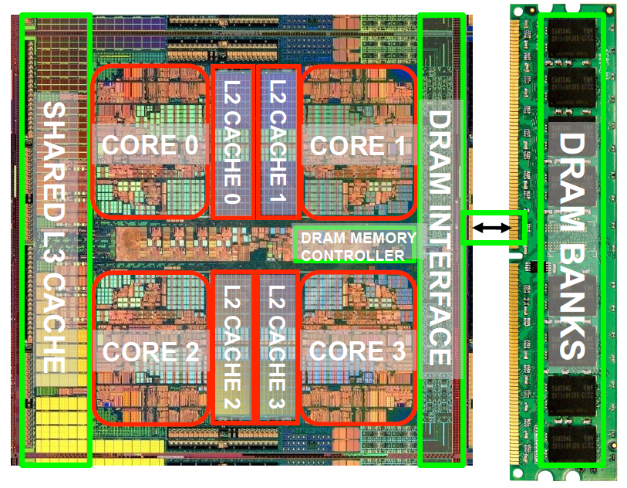
Memory Hierarchy in Multicore
Core 0
L1D
L2 Cache
L3 Cache
(LLSC)
(Off Chip)
Main
Memory
L1I
Core 1
L1D
Memory
Controller
Hit
L1I
...
Core 14
L1D
L2 Cache
L1I
Miss
Core 15
L1D
L1I
Multi-Core Processor

Slide 7
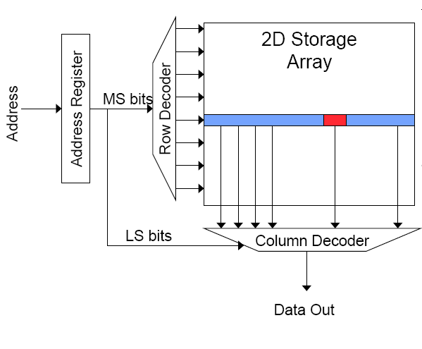
Memory Bank Organization

Slide 8
SRAM vs. DRAM
SRAM is preferable for register files and L1/L2 caches
Fast access
No refreshes
Simpler manufacturing (compatible with logic process)
Lower density (6 transistors per cell)
Higher cost
DRAM is preferable for stand-alone memory chips
Much higher capacity
Higher density
Lower cost
Reading: S. Rixner, et. al, “Memory Access Scheduling”, ISCA 2000

Slide 9
Memory subsystem organization
Memory subsystem organization
Channel
DIMM
Rank
Chip
Bank
Row/Column

Slide 10
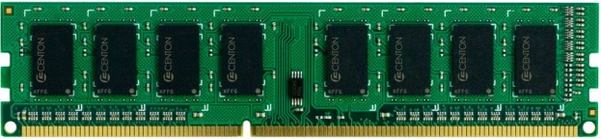
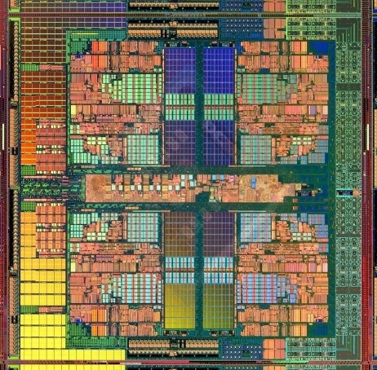
Memory subsystem
“Channel”
DIMM (Dual in-line memory module)
Memory channel
Memory channel
CORE 0
L2 CACHE 1
CORE 1
L2 CACHE 0
SHARED L3 CACHE
DRAM MEMORY CONTROLLER
DRAM INTERFACE
CORE 2
CORE 3
L2 CACHE 2
L2 CACHE 3

Slide 11
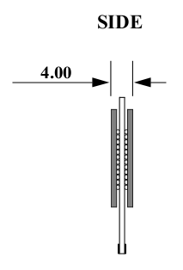
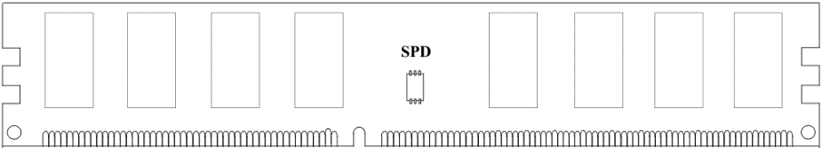
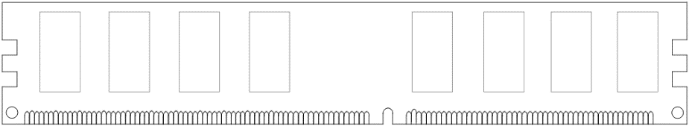
Breaking down a DIMM
DIMM (Dual in-line memory module)
Side view
Front of DIMM
Back of DIMM
Rank 0: collection of 8 chips
Rank 1

Slide 12
Rank
Rank 0 (Front)
Rank 1 (Back)
<0:63>
<0:63>
Addr/Cmd
CS <0:1>
Data <0:63>
Memory channel

Slide 13
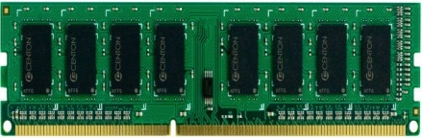
Breaking down a Rank
. . .
Chip 0
Chip 1
Chip 7
Rank 0
<0:63>
<0:7>
<8:15>
<56:63>
Data <0:63>

Slide 14
Breaking down a Chip
8 banks
Chip 0
Bank 0
<0:7>
<0:7>
<0:7>
...
<0:7>
<0:7>

Slide 15
Breaking down a Bank
2kB
1B (column)
row 16k-1
Bank 0
...
row 0
<0:7>
Row-buffer
1B
1B
1B
...
<0:7>

Slide 16
Memory subsystem organization
Memory subsystem organization
Channel
DIMM
Rank
Chip
Bank
Row/Column
Ch
Rk
D
Row
Bank
Col
Dev.
Address:

Slide 17

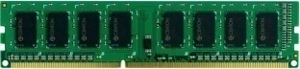
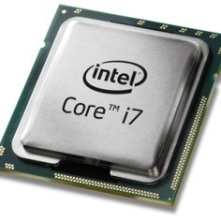
Example: Transferring a cache block
Physical memory space
0xFFFF…F
Channel 0
...
DIMM 0
Mapped to
0x40
Rank 0
64B
cache block
0x00

Slide 18
Example: Transferring a cache block
Physical memory space
Chip 0
Chip 1
Rank 0
Chip 7
0xFFFF…F
. . .
...
<0:7>
<8:15>
<56:63>
0x40
64B
cache block
Data <0:63>
0x00

Slide 19
Example: Transferring a cache block
Physical memory space
Chip 0
Chip 1
Rank 0
Chip 7
0xFFFF…F
. . .
Row 0
Col 0
...
<0:7>
<8:15>
<56:63>
0x40
64B
cache block
Data <0:63>
0x00

Slide 20
Example: Transferring a cache block
Physical memory space
Chip 0
Chip 1
Rank 0
Chip 7
0xFFFF…F
. . .
Row 0
Col 0
...
<0:7>
<8:15>
<56:63>
0x40
64B
cache block
Data <0:63>
8B
0x00
8B

Slide 21
Example: Transferring a cache block
Physical memory space
Chip 0
Chip 1
Rank 0
Chip 7
0xFFFF…F
. . .
Row 0
Col 1
...
<0:7>
<8:15>
<56:63>
0x40
64B
cache block
Data <0:63>
8B
8B
0x00
A 64B cache block takes 8 I/O cycles to transfer.
During the process, 8 columns are read sequentially.

Slide 22
Overview of a DRAM based memory
Memory Controller
Control
Address
Data
DIMM
Rank
Device
Bank
DRAM Bank
Columns
Bank
Logic
Rows
Row Buffer
Data Read (or Write) operations
Notes:
Need to say that the over all structure remains the same whether it is DRAM or PCM or any other technology

Slide 23
Page Mode DRAM
A DRAM bank is a 2D array of cells: rows x columns
A “DRAM row” is also called a “DRAM page”
“Sense amplifiers” also called “row buffer”
Each address is a <row,column> pair
Access to a “closed row”
Activate command opens row (placed into row buffer)
Read/write command reads/writes column in the row buffer
Precharge command closes the row and prepares the bank for next access
Access to an “open row”
No need for activate command

Slide 24
DRAM Bank Operation
Access Address
(Row 0, Column 0)
Access Address
(Row 0, Column 1)
Access Address
(Row 0, Column 9)
Access Address
(Row 1, Column 0)
Columns
Row address 0
Row address 1
Row decoder
Rows
Row Buffer
CONFLICT !
HIT
Row 1
HIT
Row 0
Empty
Column address 0
Column address 1
Column address 9
Column decoder
Column address 0
Data
Slide Source: Onur Mutlu, CMU

Slide 25
Basic DRAM Operations
ACTIVATE ➔ Bring data from DRAM core into the row-buffer
READ/WRITE ➔ Perform read/write operations on the contents in the row-buffer
PRECHARGE ➔ Store data back to DRAM core (ACTIVATE discharges capacitors), put cells back at neutral voltage
Memory Requests
M
H
M
PRE
ACT
RD
RD
PRE
ACT
RD
Row buffer hits are faster and
consume less power
Notes:
Once again need to say that the operations are same for other technologies too

Slide 26
Latency Components in DRAM Operation
Timing Constraints – DDR3 (1066)

Slide 27
Latency Components: Basic DRAM Operation
CPU → controller transfer time
Controller latency
Queuing & scheduling delay at the controller
Access converted to basic commands
Controller → DRAM transfer time
DRAM bank latency
Only Rd/Wr if row is “open” OR
Act + Rd/Wr if array is precharged OR
Pre + Act + Rd/Wr (worst case)
Data Burst time
Read multiple consecutive columns (4/8/16) in succession
DRAM → CPU transfer time (through controller)

Slide 28
Multiple Banks (Interleaving) and Channels
Multiple banks
Enable concurrent DRAM accesses
Bits in address determine which bank an address resides in

Slide 29
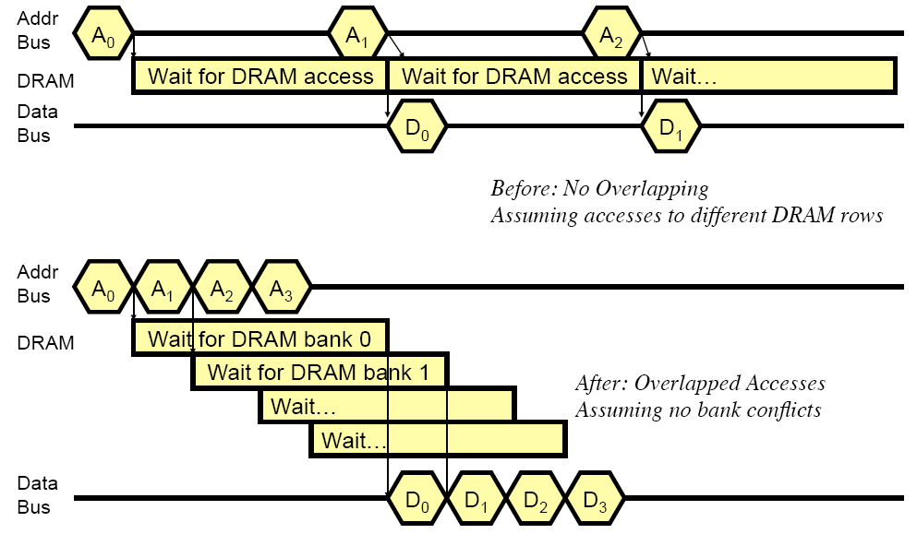
How Multiple Banks/Channels Help

Slide 30
Address Mapping (Single Channel)
Single-channel system with 8-byte memory bus
2GB memory, 8 banks, 16K rows & 2K columns per bank
Row interleaving
Consecutive rows of memory in consecutive banks
Row (14 bits)
Bank (3 bits)
Column (11 bits)
Byte in bus (3 bits)

Slide 31
Example: Transferring a cache block
Physical memory space
Chip 0
Chip 1
Rank 0
Chip 7
0xFFFF…F
. . .
Bank 0 Row 0
Col 8:15
Bank 0
Row 0
Col 0:7
...
64B
<0:7>
<8:15>
<56:63>
0x40
64B
64B
cache block
Data <0:63>
0x00

Slide 32
Address Mapping (Single Channel)
Single-channel system with 8-byte memory bus
2GB memory, 8 banks, 16K rows & 2K columns per bank
Row interleaving
Consecutive rows of memory in consecutive banks
Cache block interleaving
Consecutive cache block addresses in consecutive banks
64 byte cache blocks
Accesses to consecutive cache blocks can be serviced in parallel
How about random accesses? Strided accesses?
Row (14 bits)
Bank (3 bits)
Column (11 bits)
Byte in bus (3 bits)
Row (14 bits)
High Column
Bank (3 bits)
Low Col.
Byte in bus (3 bits)
8 bits
3 bits

Slide 33
Example: Transferring a cache block
Physical memory space
Chip 0
Chip 1
Rank 0
Chip 7
0xFFFF…F
. . .
Bank 1
Row 0
Col 0:7
Bank 0
Row 0
Col 0:7
...
64B
<0:7>
<8:15>
<56:63>
0x40
64B
64B
cache block
Data <0:63>
0x00

Slide 34
Multiple Banks (Interleaving) and Channels
Multiple banks
Enable concurrent DRAM accesses
Bits in address determine which bank an address resides in
Multiple independent channels serve the same purpose
But they are even better because they have separate data buses
Increased bus bandwidth
Enabling more concurrency requires reducing
Bank conflicts
Channel conflicts
How to select/randomize bank/channel indices in address?
Lower order bits have more entropy
Randomizing hash functions (XOR of different address bits)

Slide 35
Interaction with Virtual→Physical Mapping
Operating System influences where an address maps to in DRAM
Operating system can control which bank a virtual page is mapped to. It can randomize Page→<Bank,Channel> mappings
Application cannot know/determine which bank it is accessing
Virtual Page number (36 bits)
Page offset (12 bits)
VA
Physical Frame number (19 bits)
Page offset (12 bits)
PA
Row (14 bits)
Bank (3 bits)
Column (11 bits)
Byte in bus (3 b)
PA

Slide 36
DRAM Refresh
Capacitors leak and lose charge → Need periodic restoration of charge
JEDEC Spec: At normal temp, cell retention time limit is 64ms. At high (extended) temp, retention time halves to 32ms.
The memory controller issues refresh operations periodically.
…
Normal Access
Normal Access
Normal Access
Normal Access
Normal Access
Refresh
Normal Access
10 – 30 ns
2.56 ms
Assume 4GB DRAM with 2KB pages, organized as 16 banks
2M pages total, 128K pages per bank
Refreshing a page takes 20ns (ACTIVATE+PRECHARGE)
Refreshing all pages in a bank ➔ 2.56ms!
➔ 2.56/64 = 4% overhead!

Slide 37
DRAM Refresh (I)
Burst refresh: All rows refreshed immediately after one another
-- Implications on performance?
-- DRAM bank unavailable while being refreshed
-- Long pause times: If we refresh all rows in burst, every 64ms the DRAM will be unavailable until refresh ends
Distributed refresh: Each row refreshed at a different time, at regular intervals

Slide 38
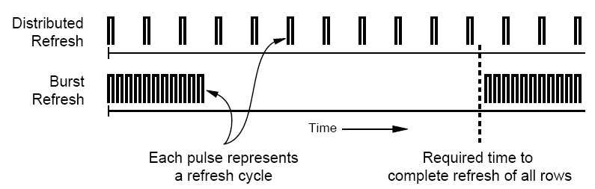
DRAM Refresh (II)
Distributed refresh eliminates long pause times
How else we can reduce the effect of refresh on performance?
Can we reduce the number of refreshes?

Slide 39
DRAM Controller
Purpose and functions
Ensure correct functioning of DRAM (refresh)
Service DRAM requests while obeying timing constraints of DRAM chips
Constraints: resource conflicts (bank, bus, channel), minimum write-to-read delays
Translate requests to DRAM command sequences
Buffer and schedule requests to improve performance
Reordering and row-buffer management
Manage power consumption and thermals in DRAM
Turn on/off DRAM chips, manage power modes

Slide 40
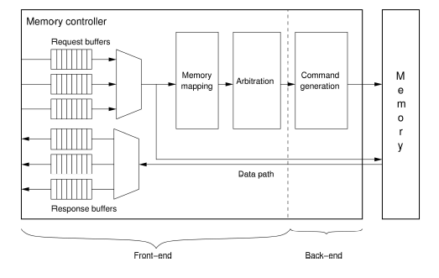
DRAM Memory Controller
Frontend
Request/Response Buffers
Memory mapping
Arbiter
Controller Backend
Command Generator
Timing to be obeyed
Notes:
Once again need to say that the operations are same for other technologies too

Slide 41
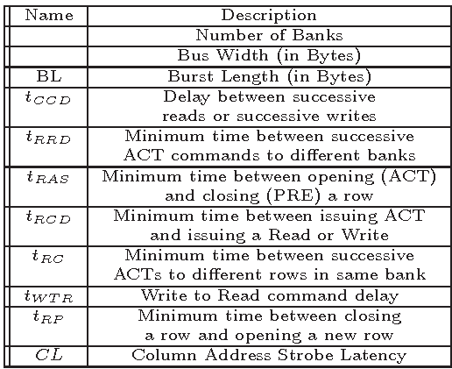
DRAM Parameters
Notes:
Once again need to say that the operations are same for other technologies too

Slide 42
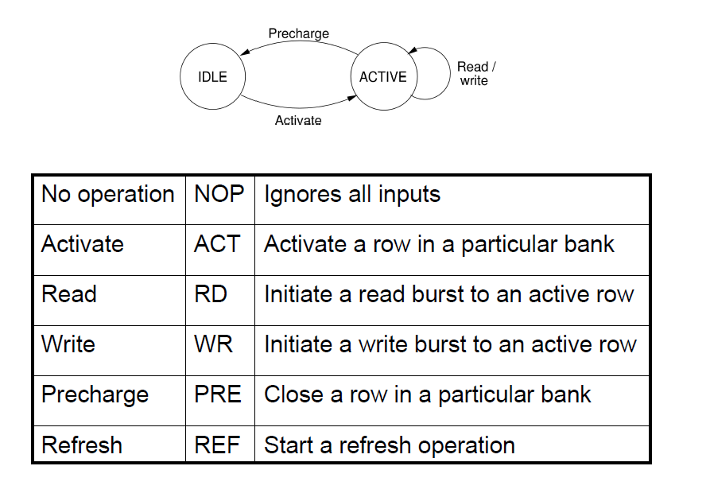
DRAM Command Summary
Notes:
Once again need to say that the operations are same for other technologies too

Slide 43
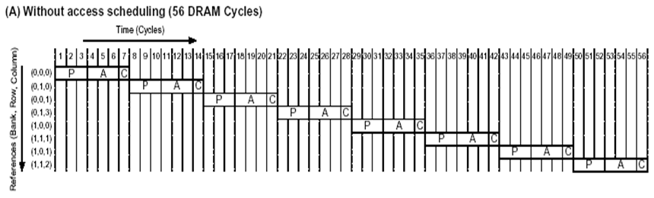
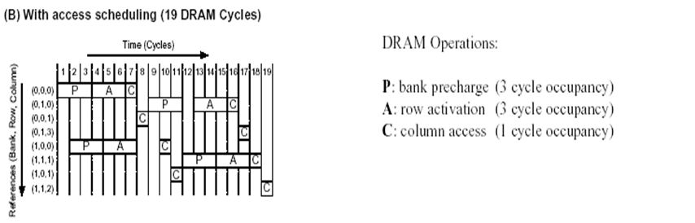
Memory Access Scheduling: Motivation

Slide 44
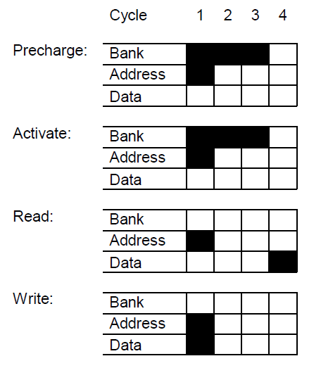
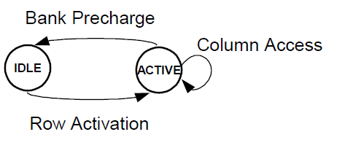
Memory State Diagram & Resource Usage

Slide 45
Memory Access Scheduling
A row-conflict memory access takes significantly longer than a row-hit access
Current controllers take advantage of the row buffer
Commonly used scheduling policy (FR-FCFS) [Rixner, ISCA’00]
(1) Row-hit (column) first: Service row-hit memory accesses first
(2) Oldest-first: Then service older accesses first
This scheduling policy aims to maximize DRAM throughput
Slide Source: Onur Mutlu, CMU

Slide 46
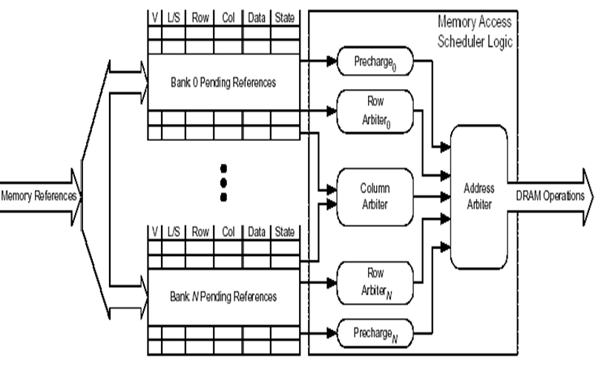
Memory Access Scheduler
Selects one or more operations (Precharge, Activate, or Column Access) each cycle

Slide 47
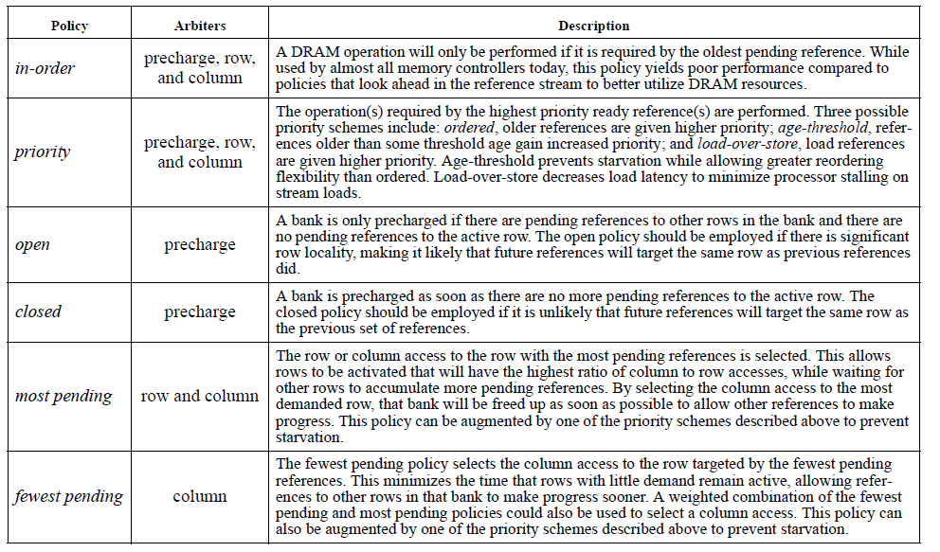

Slide 48
FRFCFS Scheduling
Row decoder
T0: Row 0
T0: Row 0
T0: Row 0
T0: Row 0
T0: Row 0
T0: Row 0
T0: Row 0
T1: Row 5
T0: Row 0
T1: Row 111
T0: Row 0
T1: Row 16
Request Buffer
Row 0
Row 0
Row Buffer
Column decoder
T0: streaming thread
T1: non-streaming thread
Data
Slide Source: Onur Mutlu, CMU

Slide 49
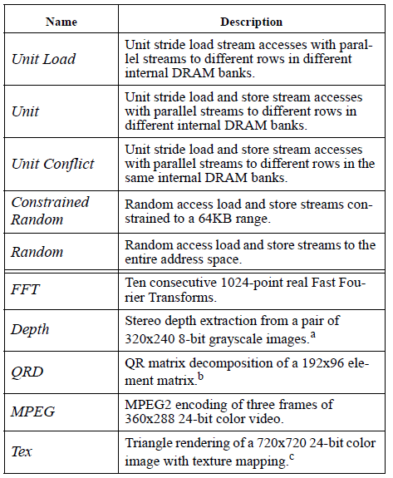
Benchmarks

Slide 50
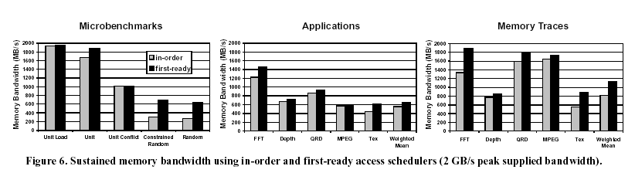
The 14% drop in sustained bandwidth from the unit load benchmark to the unit benchmark shows the performance degradation imposed by forcing intermixed load and store references to complete in order.
The unit conflict benchmark further shows the penalty of swapping back and forth between rows in the DRAM banks, which drops the sustainable bandwidth down to 51% of the peak.
The random benchmarks sustain about 15% of the bandwidth of the unit load benchmark.

Slide 51
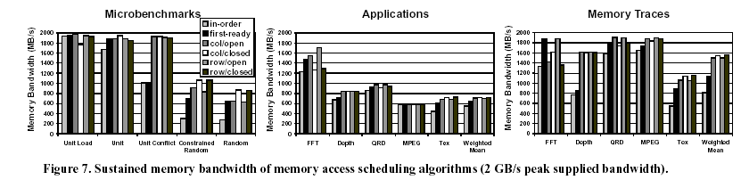
The Figure presents the sustained memory bandwidth for each
memory access scheduling algorithm on the given benchmarks.
These aggressive scheduling algorithms improve the
memory bandwidth of the microbenchmarks by 106-144%,
the applications by 27-30%, and the application traces by
85-93% over in-order scheduling.

Slide 52
Things to Ponder
How about the cost of implementing the Memory Access Scheduler?
How about the extra logic and the power dissipation?
Why contemporary cache organizations waste memory bandwidth to reduce memory latency ?

Slide 53
Major Trends Affecting Memory
Need for main memory capacity and bandwidth increasing
New need for handling inter-application interference; providing fairness, QoS
Main memory energy/power is a key system design concern
DRAM is not scaling well
New memory technologies becoming available!
Non-volatile memory
Stacked DRAM memory

Slide 54
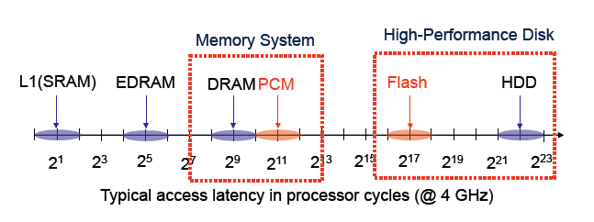
Emerging Memory Technology
Non-Volatile Memory technology
Phase Change Memory (PCM), Magnetic RAM (MRAM), Resistive RAM (RRAM), Spin Torque Transfer RAM (STT-RAM), …
Slide Source: Moin Quereshi, Georgia Tech.

Slide 55
Emerging Memory Technology
Phase Change Memory
Data stored by changing phase of a special material
Phase change material (chalcogenide glass) exists in two states:
Amorphous: high resistivity – reset state or 0
Crystalline: low resistivity – set state or 1
Data read by detecting material’s resistance
Non-volatality and low idle power (no refresh)
Expected to scale (to 9nm), denser than DRAM, and can store multiple bits/cell
Higher Write latency and write-energy
Endurance issues (cell dies after 10⁸ writes)
Slide Source: Onur Mutlu, CMU

Slide 56
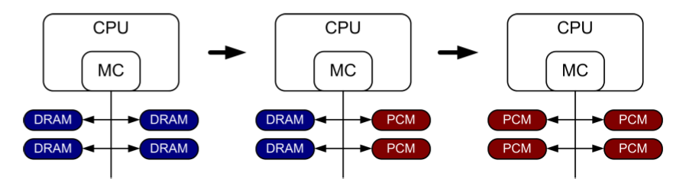
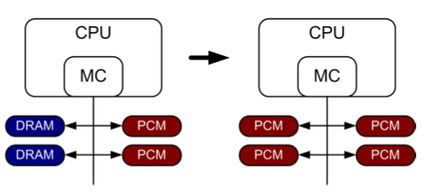
DRAM – PCM Hybrid Memory
PCM-based (main) memory be organized?
Hybrid PCM+DRAM
How to partition/migrate data between PCM and DRAM
Is DRAM a cache for PCM or part of main memory?
How to design the hardware and software
Slide Source: Onur Mutlu, CMU

Slide 57
PCM-based Main Memory
How should PCM-based (main) memory be organized?
Pure PCM main memory [Lee et al., ISCA’09, Top Picks’10]:
How to redesign entire hierarchy (and cores) to overcome PCM shortcomings
Slide Source: Onur Mutlu, CMU

Slide 58
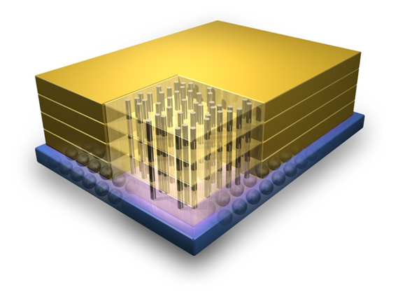
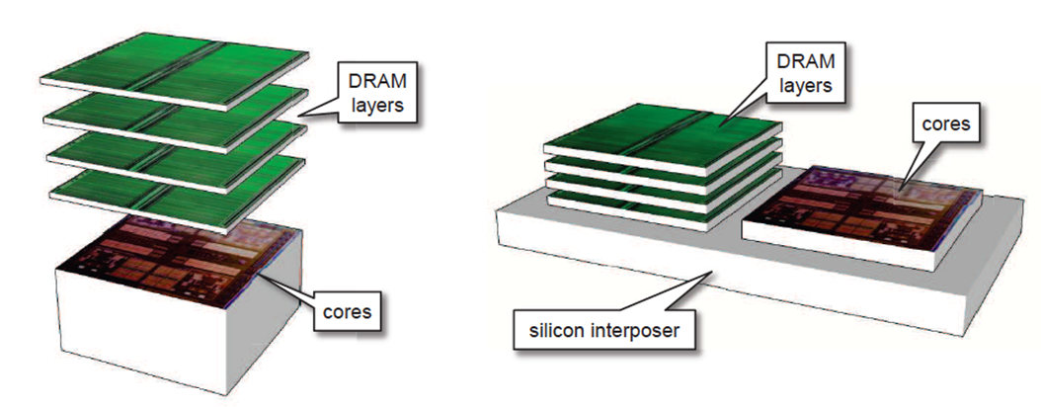
Stacked DRAM
DRAM vertically stacked on the processor die.
Stacked DRAMs offer
High bandwidth
Large capacity
Same or slightly lower latency.
Can be used as
Cache or
Part of Memory
3-D Stacked DRAM
2.5-D Stacked DRAM

Slide 59
Processor Orgn. With DRAM Cache
Core 0
L1D
(Off Chip)
Main
Memory
L1I
Stacked
DRAM
Cache
(~1GB)
L2
(LLSC)
(~8MB)
Core 1
L1D
L1I
Hit
.
.
.
Miss
Core N
L1D
Memory
Controller
L1I
Processor with Stacked DRAM

Slide 60
Problems in Architecting Large DRAM Caches
Small cache line size (64 B): Lower spatial locality, but reduced wasted bandwidth and cache capacity
Problem: Large tag store of 10’s of MB
E.g. 256MB DRAM cache needs ~20MB tag store
Large cache block size (2048B)
Low tag store overhead – SRAM tag-store
Problem: wasted off-chip bandwidth and wasted cache capacity
Option 1: SRAM Tags
Low Hit Time, but Impractical (Large SRAM)
[AlloyCache, ATCache]
Option 2: Tags in DRAM
Naïve design has 2x latency
(Two accesses -- tag and data)
[FootPrintCache, CHOP]

Slide 61
Processor Orgn. With DRAM Cache
Core 0
L1D
(Off Chip)
Main
Memory
DRAM
Cache
(Vertically
Stacked)
L1I
MetaData on DRAM
L2
(LLSC)
Core 1
L1D
Hit
L1I
Tag-Pred
MetaData on SRAM
.
.
.
Miss
Core N
L1D
Memory
Controller
L1I
Processor with Stacked DRAM

Slide 62
Research Issues in Multicore Memory Hierarchy
C0
C1
C2
C3
L1$
L1$
L1$
L1$
Cache Sharing across Multi-cores
DRAM Cache
L2-Cache
Memory Controller
Scheduling of Memory Request
Memory
Memory Organization/ Technology

Slide 63
Architecture/System Trends
Sharing of memory hierarchy
More cores and components
More pressure on the memory hierarchy
Different cores have different performance requirements
Memory hierarchies do not distinguish between cores
Different goals for different systems/users
System throughput, fairness, per-application performance
Modern hierarchies are not flexible/configurable
Asymmetric cores: Performance asymmetry, CPU+GPUs, accelerators, …
Slide Source: Onur Mutlu, CMU

